Slide 1

Train Analysis
A Data Driven Study of Meteorological Impact on Railway Reliability
Presented by
Saad Ur Rehman Baig
Francesco Banfi

Slide 2
Executive Summary of the Project
INVESTIGATING WEATHER'S IMPACT ON RAILWAY DELAYS
This project aims to investigate the correlation between weather conditions and railway delays in Lombardy, using modern microservices architecture with event-driven processing.

Slide 3
Research Focus and Hypotheses Overview
RESEARCH FOCUS
HYPOTHESES
The project investigates the temporal, spatial, and operational factors influence railway delays in relation to weather conditions.
It is hypothesized that increases in rainfall and extreme temperatures will correlate with longer delays, while wind may have varying effects depending on its strength and direction.

Slide 4
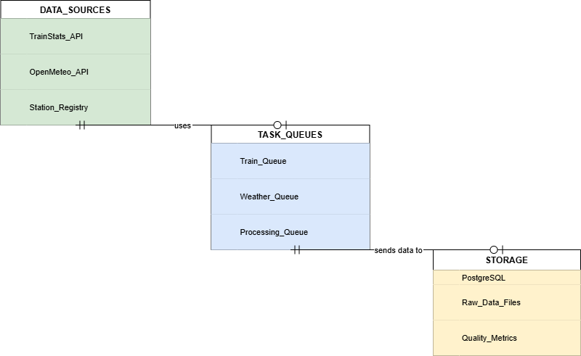
Architectural Pattern

Slide 5
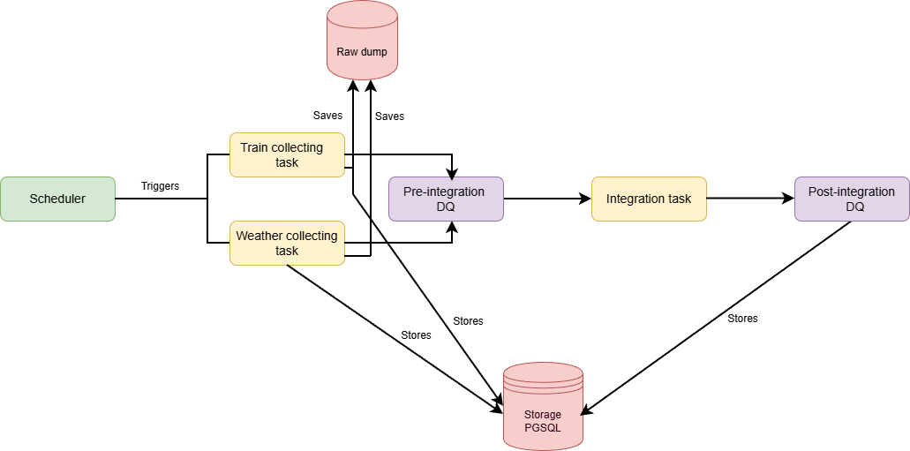
Data Flow Architecture

Slide 6
Project Components
DATA INGESTION LAYER
Pulls data from various external APIs seamlessly
DATA QUALITY LAYER
Ensures accuracy and completeness of the dataset, this exist after injestion phase and integration phase
TASK PROCESSING LAYER
We perform ingestion and integration using task-based queuing system which allow us to parallel execute these steps
DATA INTEGRATION LAYER
Integrate train data with meteorological data for analysis

Slide 7
Dataset Characteristics
3686
325
97,424
Unique Trains
Stations in Lombardia
Rainy Records
0.10 mm
−10.7 °C to 18.6 °C
4.08 min
Average Precipitation
Temperature Range
Average Delay (Clear)
4.86 min
4.02 min
5.00 min
Average Delay (Rush Hour)
Average Delay (Non-Rush)
Average Delay (Rainy)

Slide 8
Pipeline Performance
647,455
234,144
881,599
Integrated Data Records
Meteorological Observations ingested
Total ingested Records
0.66 hours
371 records/sec
90
Processing Time
Throughput
90 parallel tasks
100%
98.8%
1,335,600 records/hour
Task Success rate
Data alignment
Estimated Max Ingestion Capacity

Slide 9
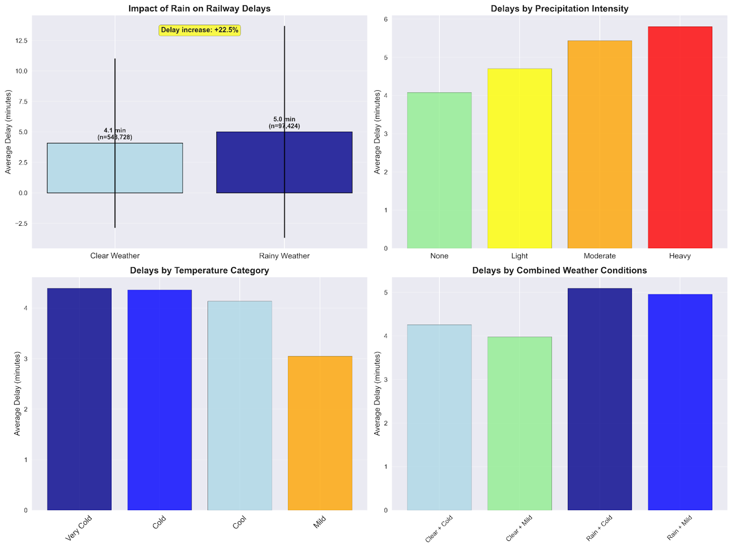
Exploratory Data Analysis - 1

Slide 10
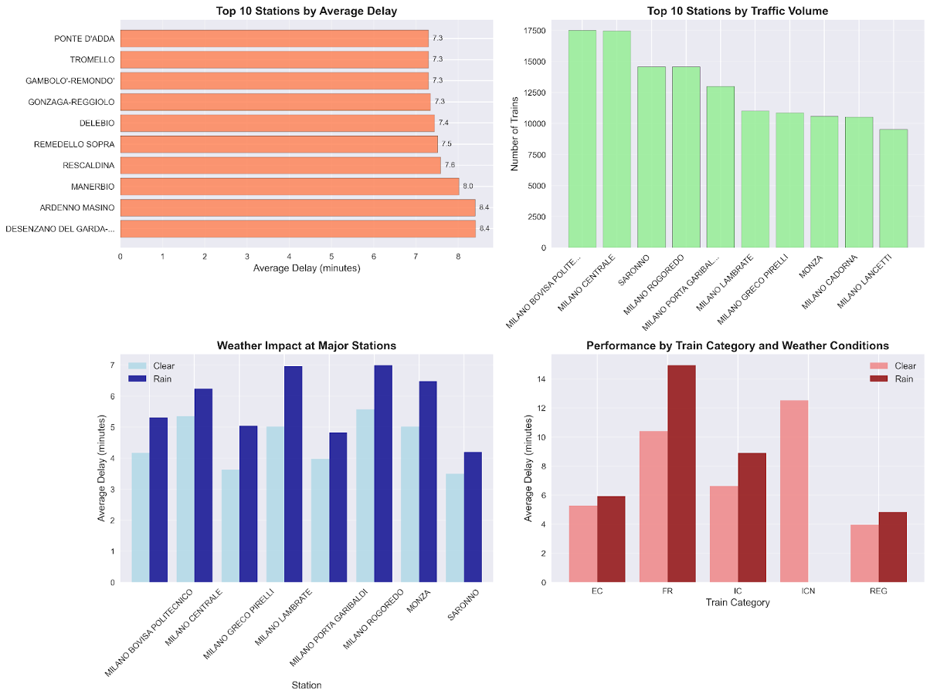
Exploratory Data Analysis - 2

Slide 11
Future Developments
Short term Enhancements
Introduction of real-time data processing, streaming capabilities, operational dashboards, and automated analytical pipelines.
Medium term Enhancements
Expand coverage across Italy and enhance performance by upgrading technology and optimization practices, including Airflow orchestration and caching mechanisms.
Long term Enhancements
Build intelligent train analysis system with ML for prediction of delay and cancellation.

Slide 12
CONCLUSION
The project analyzed how weather conditions influence railway delays in Lombardy by building a data pipeline with strong quality controls and integrated datasets.
Results show a mild correlation between weather especially rainfall and delay duration, but the overall impact is moderate.
Because the dataset covers a limited timeframe without extreme weather events, the findings are indicative rather than conclusive.
Expanding the historical data would help make the results conclusive and would help in predictive modeling
Overall, the project proves that a well-designed data pipeline can handle complex data integration and provide meaningful insights into the relationship between weather and train delays.

